Slide 1
预训练-前世今生

Slide 2
目录
Word2vec
ELMO
GPT
BERT
XL-NET

Slide 3
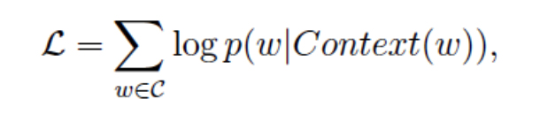
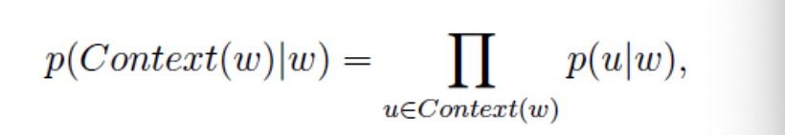
WORD2VEC
CBOW：
给定单词的context上下文，预测当前单词
SKIP-GRAM：
给定当前单词，预测当前单词的context上下文

Slide 4
WORD2VEC
优点：
1、能够挖掘语义信息
2、训练速度快，可并行
缺点：
1、无法解决一词多义（“苹果”是水果还是公司）
2、静态词向量（上下文无关）
https://arxiv.org/abs/1301.3781
https://www.cnblogs.com/peghoty/p/3857839.html

Slide 5
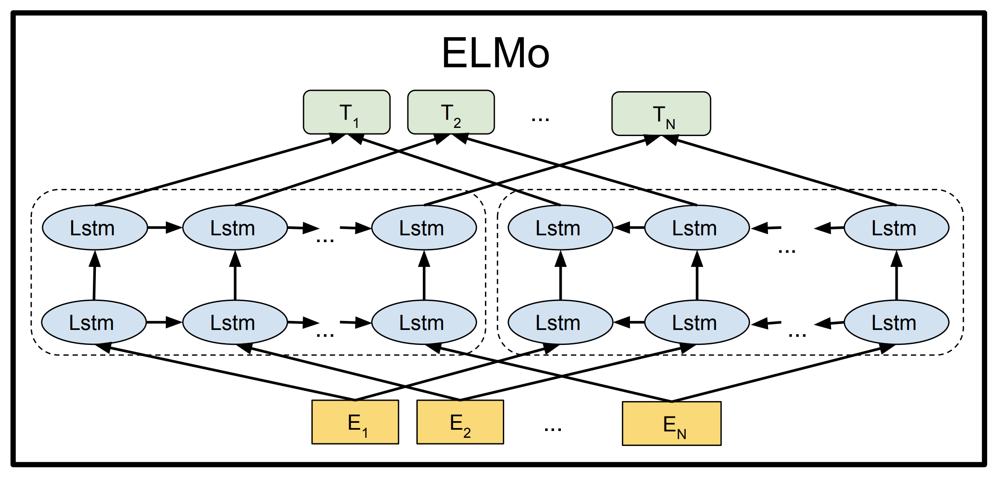
ELMO
训练双向语言模型

Slide 6
ELMO
优点：
1、双向语言模型，表征能力更强
2、动态词向量（上下文有关）
缺点：
1、无法并行训练
2、缺乏attention
https://allennlp.org/elmo
https://arxiv.org/abs/1802.05365
http://colah.github.io/posts/2015-08-Understanding-LSTMs/

Slide 7
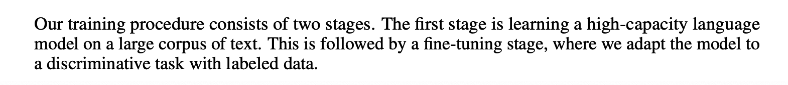
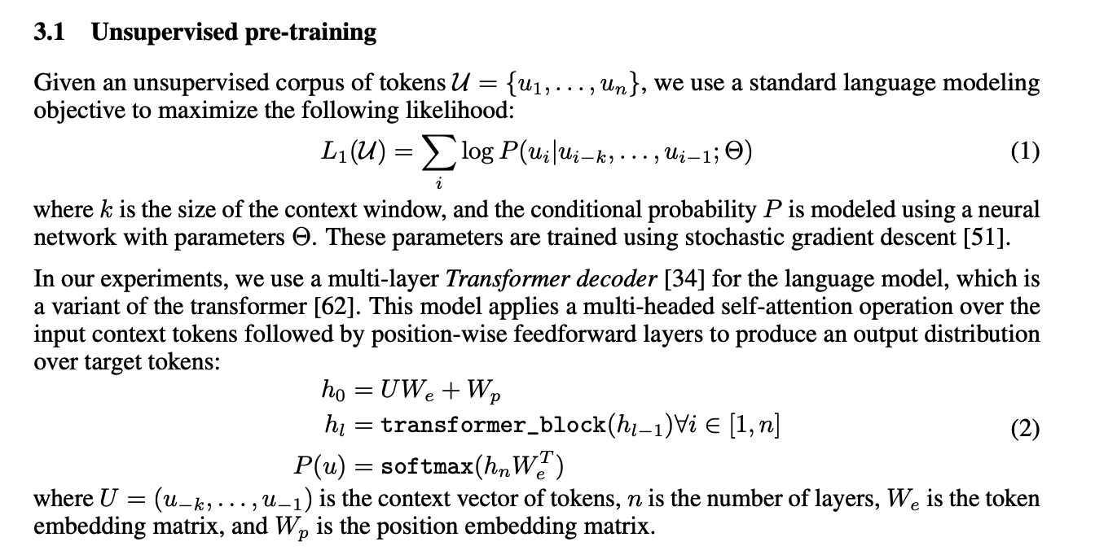
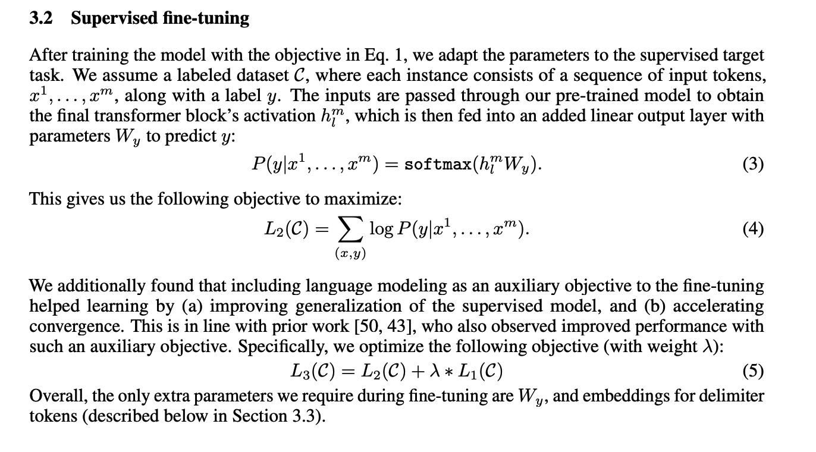
GPT

Slide 8
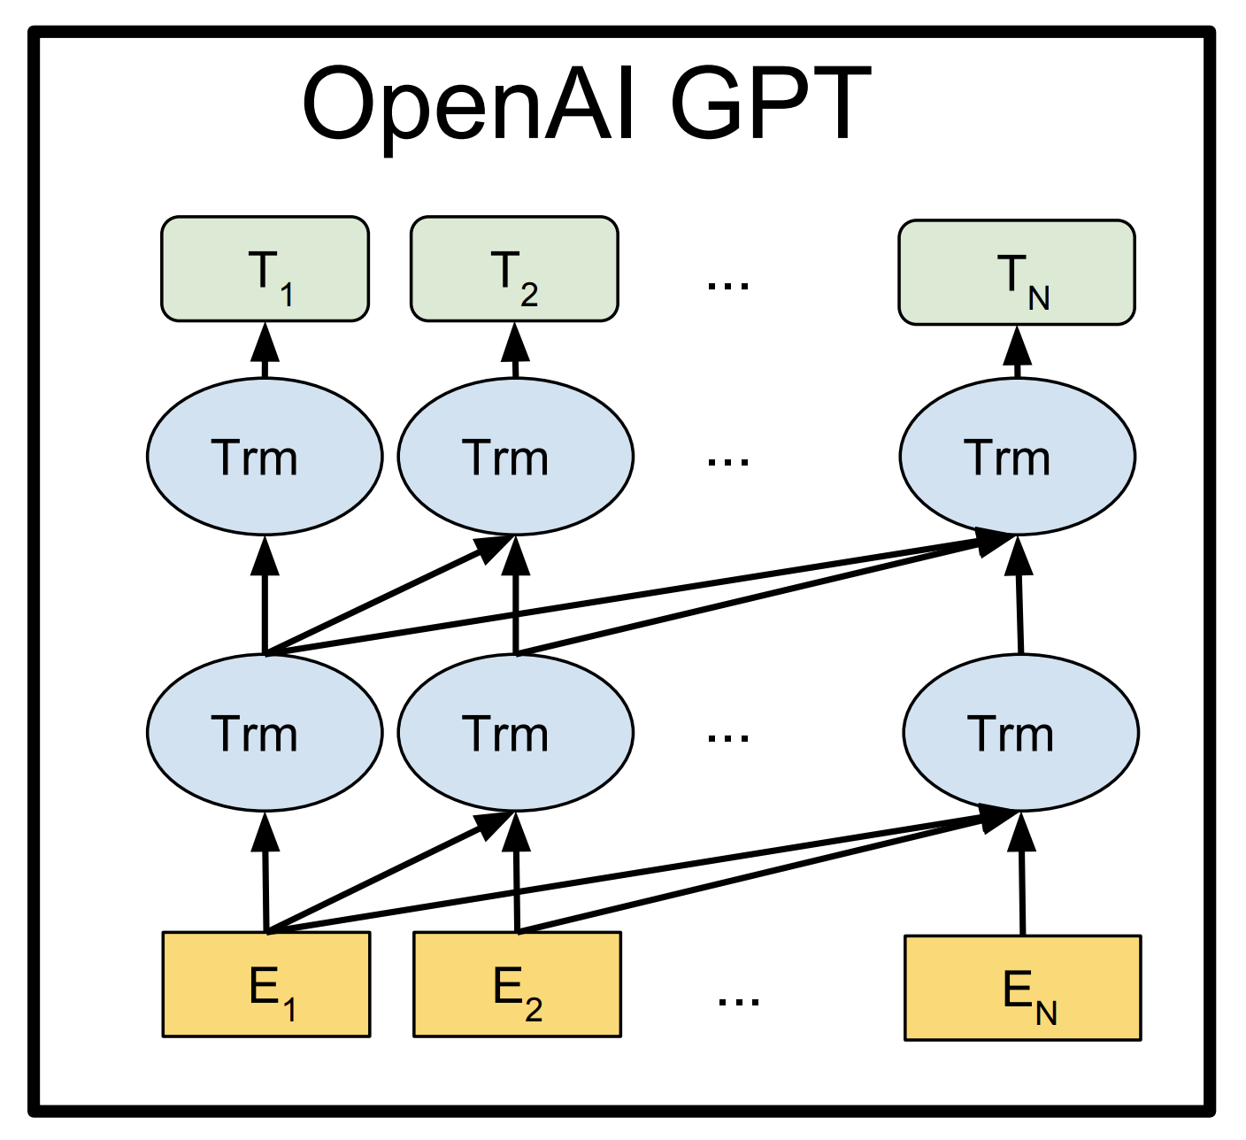
GPT
模型结构

Slide 9
GPT
优点：
1、 Transformer可以捕捉到更长范围的信息
2、计算速度比循环神经网络更快，易于并行化
缺点：
1、单向语言模型
2、有些rnn轻易可以解决的问题transformer没做到
https://s3-us-west-2.amazonaws.com/openai-assets/
research-covers/language-unsupervised/language_understanding_paper.pdf

Slide 10
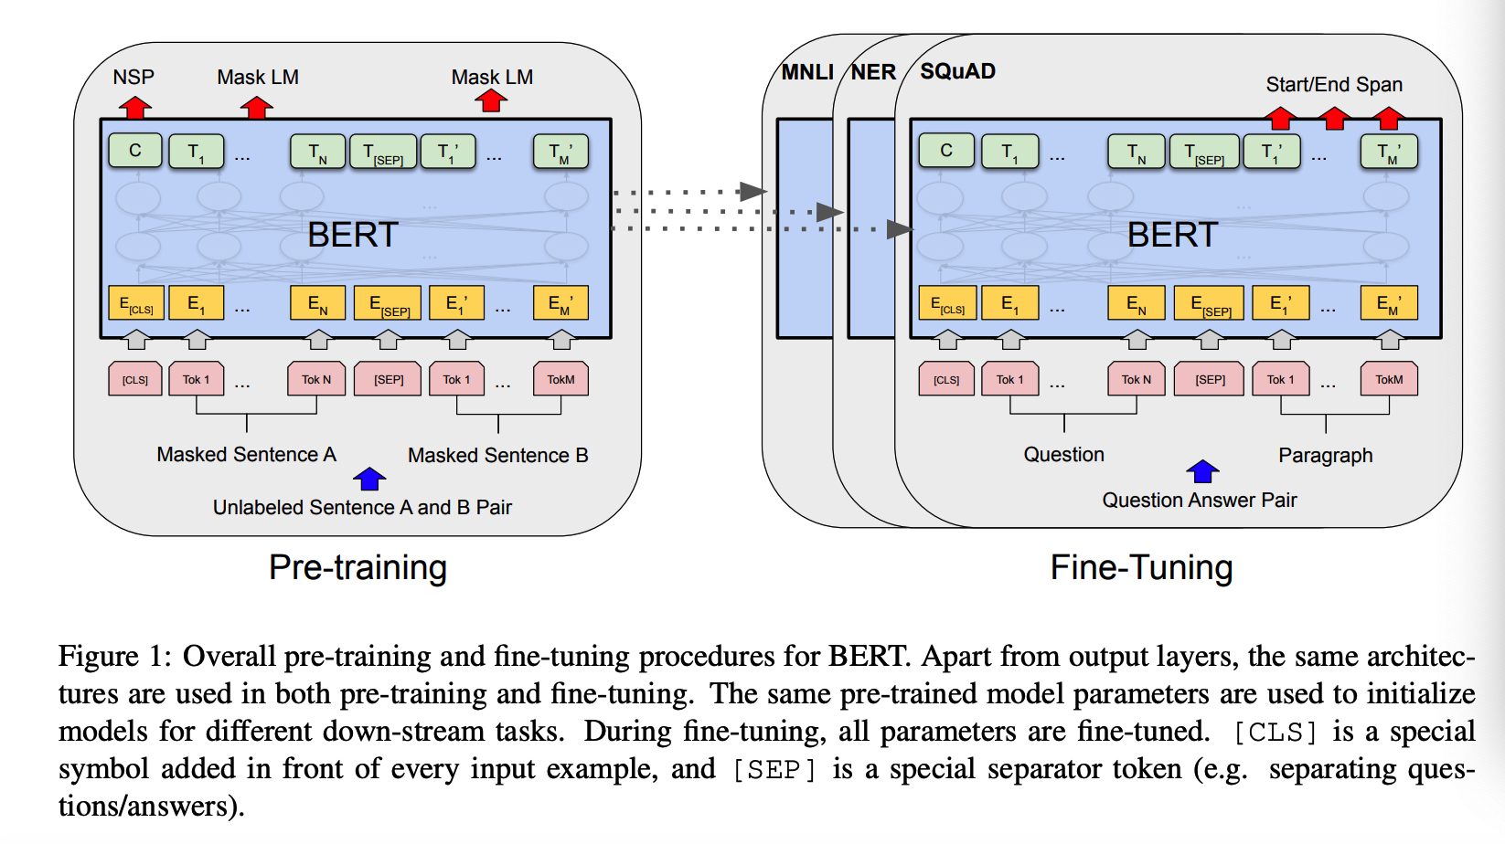
BERT
do not use traditional left-to-right or right-to-left language models to pre-train BERT. Instead,use:
#1、Masked LM
#2、Next Sentence Prediction (NSP)

Slide 11
BERT
Masked LM
Assuming the unlabeled sentence is my dog is hairy, and during the random masking procedure we chose the 4-th token (which corresponding to hairy), our masking procedure can be further illustrated by：
1、80% of the time: Replace the word with the [MASK] token, e.g., my dog is hairy → my dog is [MASK]
2、 10% of the time: Replace the word with a random word, e.g., my dog is hairy → my dog is apple
3、 10% of the time: Keep the word unchanged, e.g., my dog is hairy → my dog is hairy. The purpose of this is to bias the representation towards the actual observed word.
这么做的原因是如果句子中的某个Token100%都会被mask掉，那么在fine-tuning的时候模型就会有一些没有见过的单词。加入随机Token的原因是因为Transformer要保持对每个输入token的分布式表征，否则模型就会记住这个[mask]是token ’hairy‘，随机词替换会给模型增加一点点噪声，但是因为此时模型不知道哪个词是被随机换了(不像[MASK]，给模型[MASK]则模型知道此处词的是被挖了，他需要预测这个位置是啥)，所以就迫使他去更好地保留每个词的词义，为下游任务提供方便。至于单词带来的负面影响，因为一个单词被随机替换掉的概率只有15%*10% =1.5%，这个负面影响其实是可以忽略不计的。

Slide 12
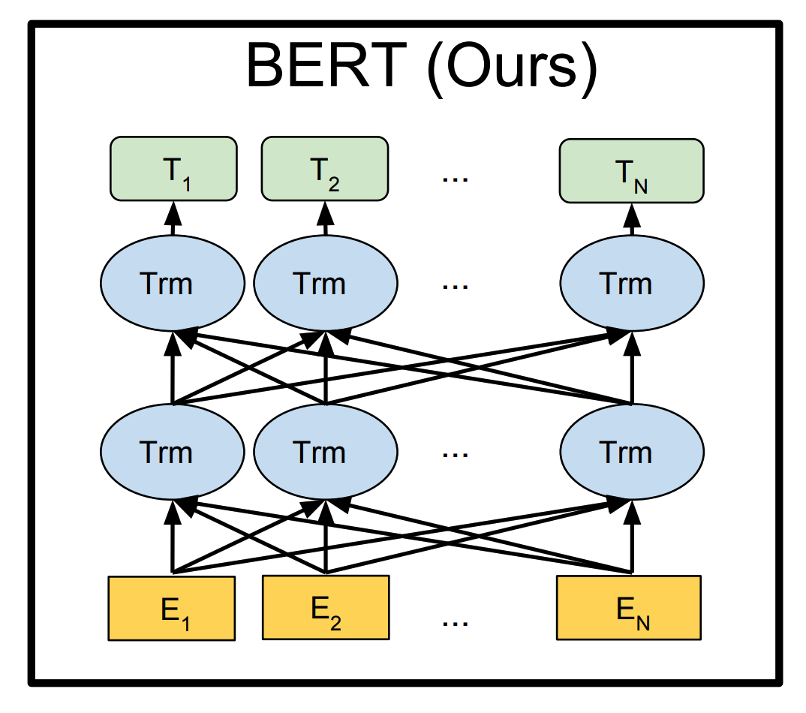
BERT
Next Sentence Prediction (NSP)
The next sentence prediction task can be illustrated in the following examples.
Input = [CLS] the man went to [MASK] store [SEP] he bought a gallon [MASK] milk [SEP]
Label = IsNext
Input = [CLS] the man [MASK] to the store [SEP] penguin [MASK] are flight ##less birds [SEP]
Label = NotNext

Slide 13
BERT
优点：
1、 Transformer可以捕捉到更长范围的信息
2、计算速度比循环神经网络更快，易于并行化
3、性能怪兽，在11种不同NLP测试中创出最佳成绩
缺点：
1、运行速度慢，参数大，吃硬件，配置要求高
2、mask-LM，引入噪声，预训练和Fine-tuning不一致
3、独立性假设，预测目标相互独立
https://arxiv.org/pdf/1810.04805.pdf
https://github.com/google-research/bert

Slide 14
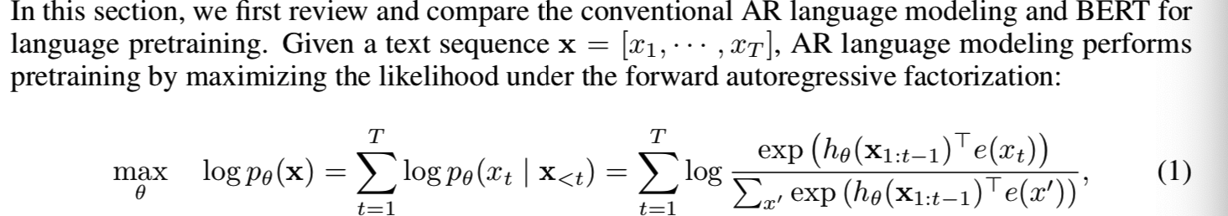
XL-NET
AR language modeling seeks to estimate the probability distribution of a text corpus with an au- toregressive model [7, 24, 25]（ELMO，GPT）. Specifically, given a text sequence x = (x1 , · · · , xT ), AR language modeling factorizes the likelihood into a forward product p(x) = 􏰇Tt=1 p(xt | x<t) or a backward one p(x) = 􏰇1t=T p(xt | x>t). A parametric model (e.g. a neural network) is trained to model each conditional distribution. Since an AR language model is only trained to encode a uni-directional context (either forward or backward), it is not effective at modeling deep bidirectional contexts. On the contrary, downstream language understanding tasks often require bidirectional context information. This results in a gap between AR language modeling and effective pretraining.

Slide 15
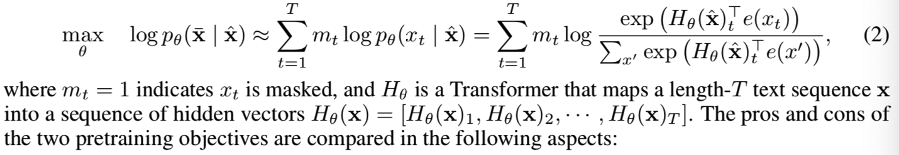
XL-NET
In comparison, AE based pretraining does not perform explicit density estimation but instead aims to reconstruct the original data from corrupted input. A notable example is BERT. Given the input token sequence, a certain portion of tokens are replaced by a special symbol [MASK], and the model is trained to recover the original tokens from the corrupted version. However, the artificial symbols like [MASK] used by BERT during pretraining are absent from real data at finetuning time, resulting in a pretrain-finetune discrepancy. Moreover, since the predicted tokens are masked in the input, BERT is not able to model the joint probability using the product rule as in AR language modeling. In other words, BERT assumes the predicted tokens are independent of each other given the unmasked tokens, which is oversimplified as high-order, long-range dependency is prevalent in natural language. BERT first constructs a corrupted version xˆ by randomly setting a portion (e.g. 15%) of tokens in x to a special symbol [MASK]. Let the masked tokens be x ̄. training objective is to reconstruct x ̄ from xˆ:

Slide 16
XL-NET
method
1、XLNet maximizes the expected log likelihood of a sequence w.r.t. all possible permutations of the factorization order. Thanks to the permutation operation, the context for each position can consist of tokens from both left and right. In expectation, each position learns to utilize contextual information from all positions, i.e., capturing bidirectional context.
2、 XLNet does not rely on data corruption. Hence, XLNet does not suffer from the pretrain-finetune discrepancy that BERT is subject to. Meanwhile, the autoregressive objective also provides a natural way to use the product rule for factorizing the joint probability of the predicted tokens, eliminating the independence assumption made in BERT.
3、 XLNet integrates the segment recurrence mechanism and relative encoding scheme of Transformer-XL [9] into pretraining, which empirically improves the performance especially for tasks involving a longer text sequence. Naively applying a Transformer(-XL) architecture to permutation-based language modeling does not work because the factorization order is arbitrary and the target is ambiguous. As a solution, we propose to reparameterize the Transformer(-XL) network to remove the ambiguity.

Slide 17
XL-NET
• Independence Assumption: As emphasized by the ≈ sign in Eq. (2), BERT factorizes the joint conditional probability p(x ̄ | xˆ) based on an independence assumption that all masked tokens x ̄ are separately reconstructed. In comparison, the AR language modeling objective (1) factorizes pθ(x) using the product rule that holds universally without such an independence assumption.
• Input noise: The input to BERT contains artificial symbols like [MASK] that never occur in downstream tasks, which creates a pretrain-finetune discrepancy. Replacing [MASK] with original tokens as in [10] does not solve the problem because original tokens can be only used with a small probability — otherwise Eq. (2) will be trivial to optimize. In comparison, AR language modeling does not rely on any input corruption and does not suffer from this issue.
• Context dependency: The AR representation hθ(x1:t−1) is only conditioned on the tokens up to position t (i.e. tokens to the left), while the BERT representation Hθ(x)t has access to the contextual information on both sides. As a result, the BERT objective allows the model to be pretrained to better capture bidirectional context.

Slide 18
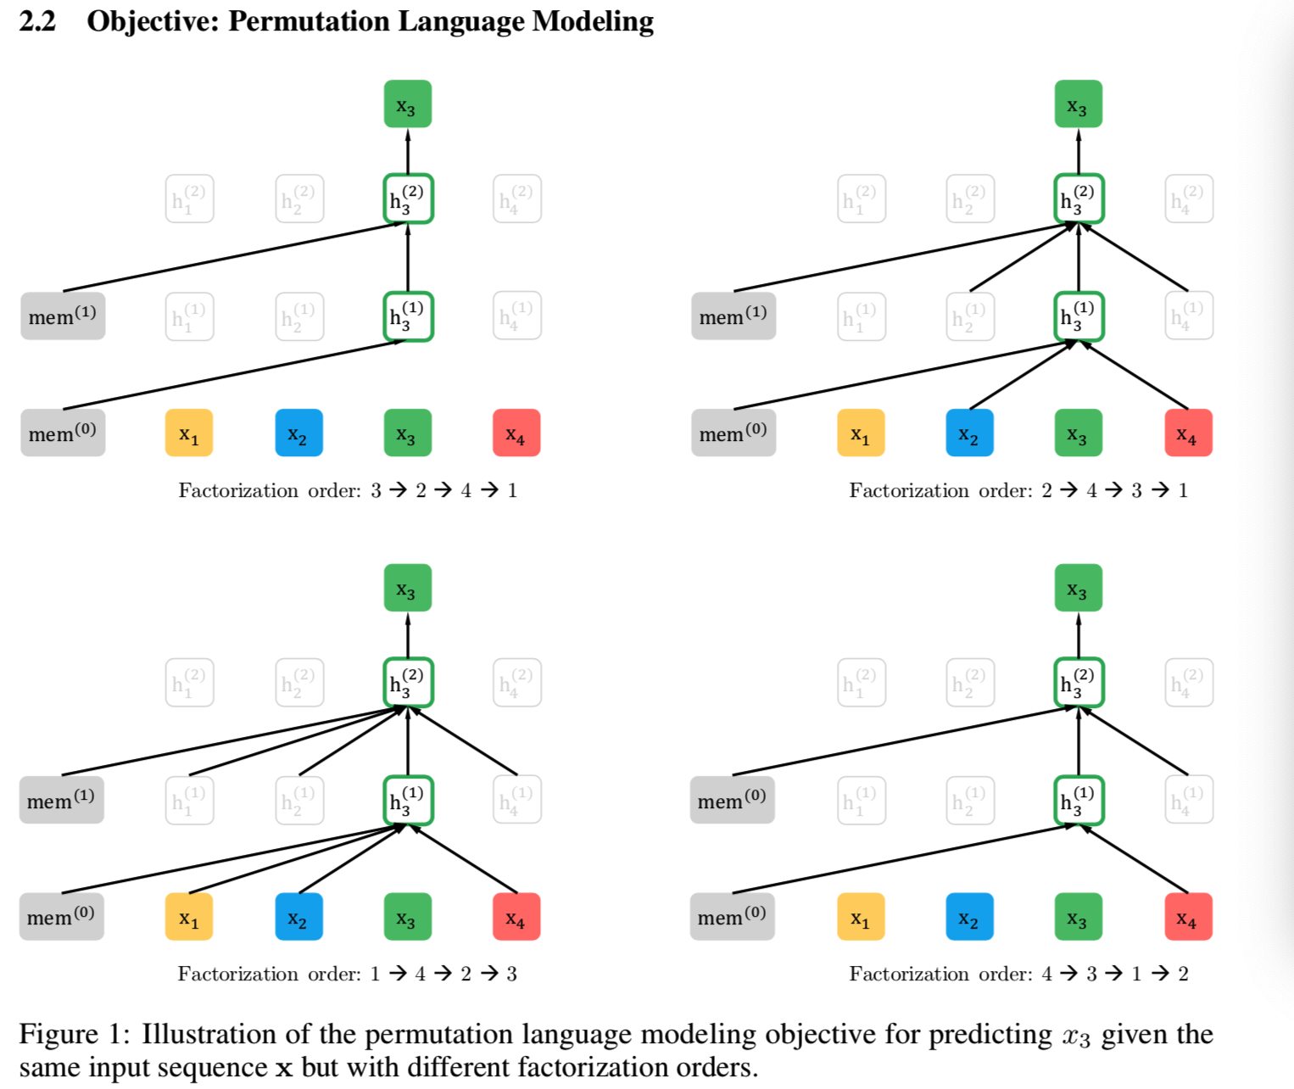
XL-NET

Slide 19
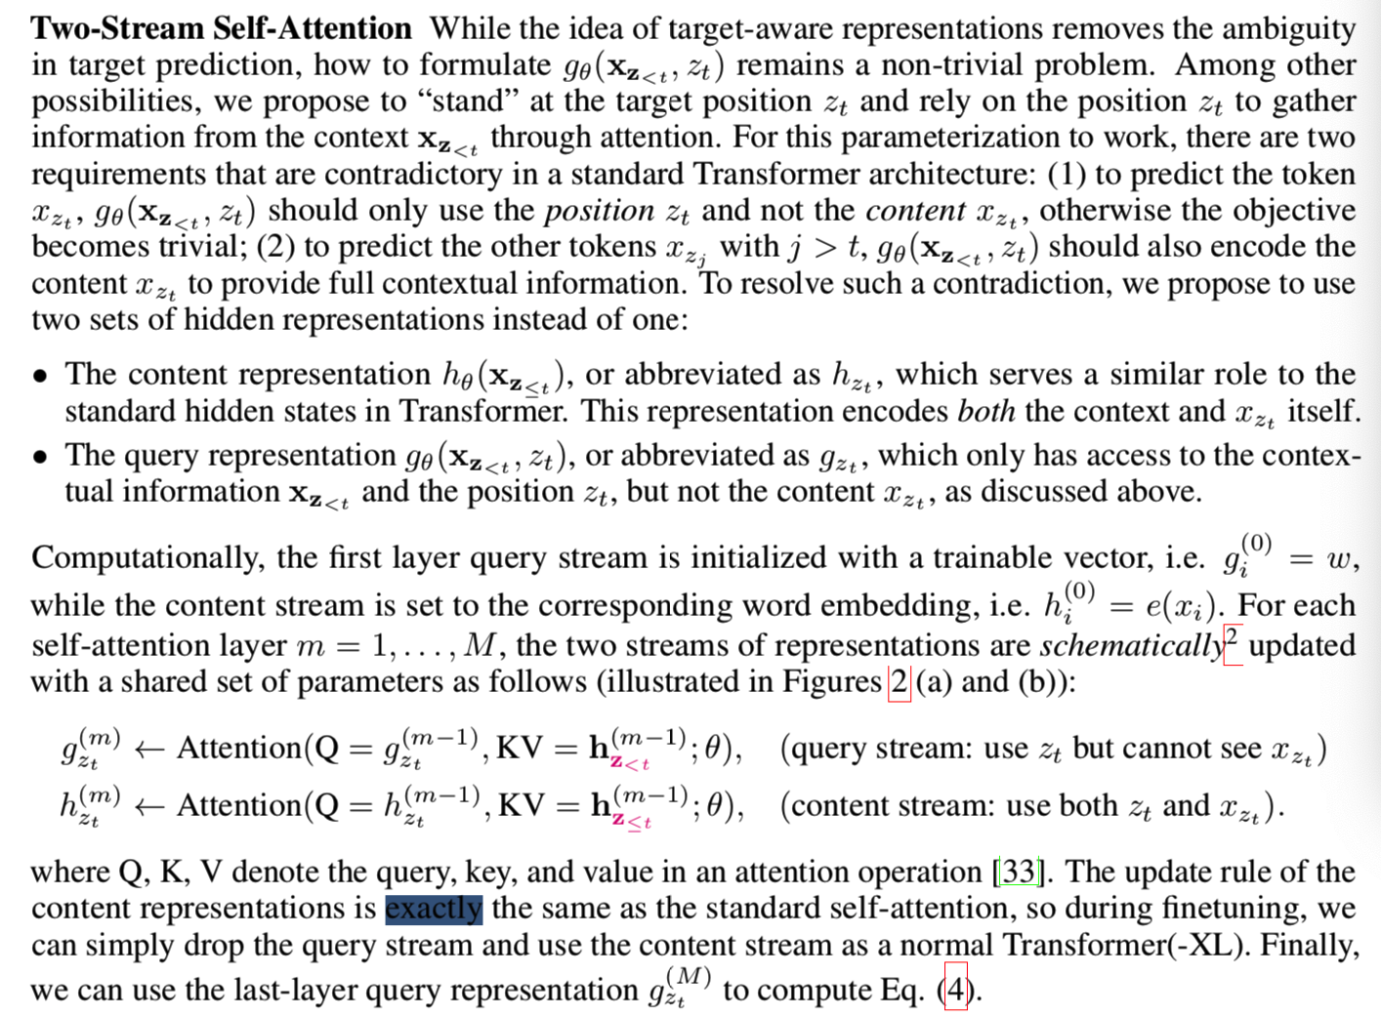
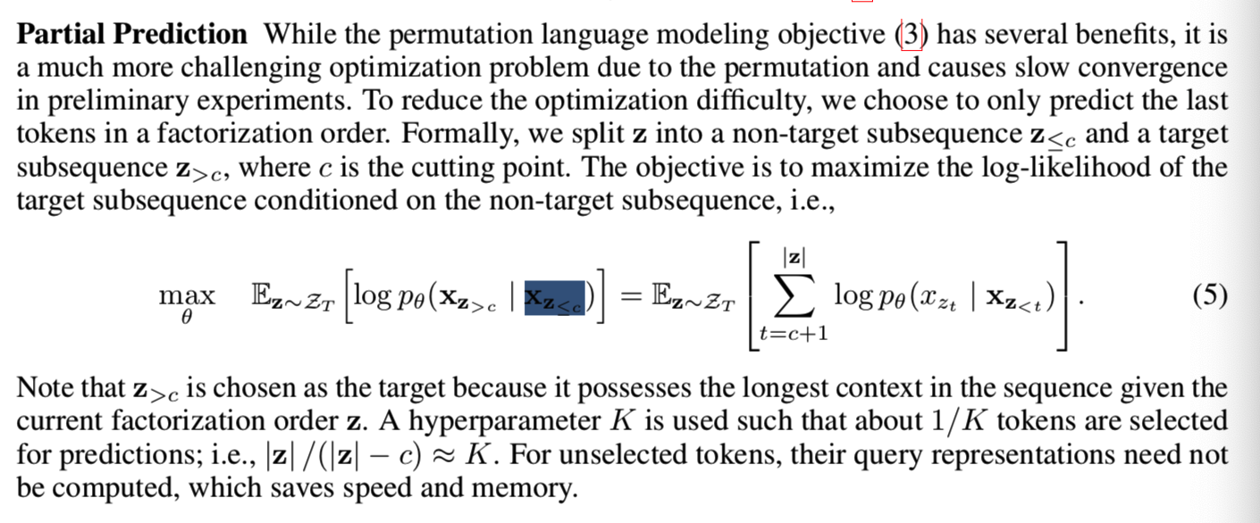
XL-NET

Slide 20
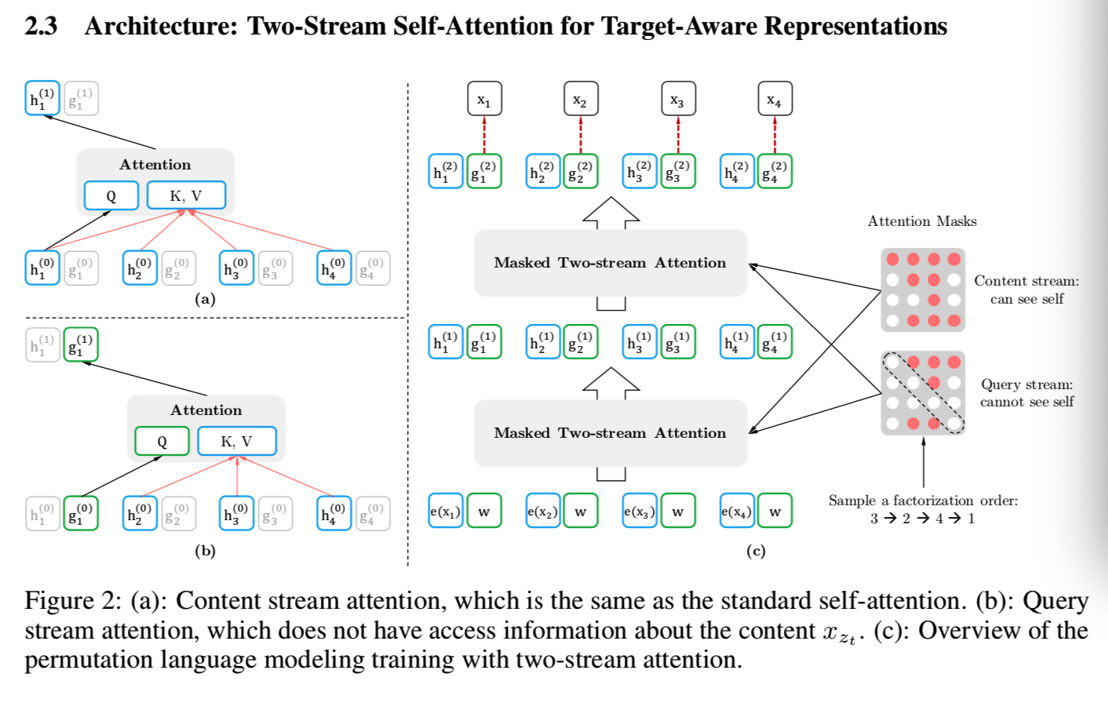
XL-NET

Slide 21
XL-NET
BERT对比
Consider a concrete example [New, York, is, a, city]. Suppose both BERT and XLNet select the two tokens [New, York] as the prediction targets and maximize log p(New York | is a city). Also suppose that XLNet samples the factorization order [is, a, city, New, York]. In this case, BERT and XLNet respectively reduce to the following objectives:
J_{BERT} = log p(New | is a city) + log p(York | is a city), J_{XLNet} = log p(New | is a city) + log p(York | New, is a city).
Notice that XLNet is able to capture the dependency between the pair (New, York), which is omitted by BERT. Although in this example, BERT learns some dependency pairs such as (New, city) and (York, city), it is obvious that XLNet always learns more dependency pairs given the same target and contains “denser” effective training signals.

Slide 22
XL-NET
GPT对比
a standard AR language model like GPT [25] is only able to cover the dependency (x = York, U = {New}) but not (x = New, U = {York}). XLNet, on the other hand, is able to cover both in expectation over all factorization orders. Such a limitation of AR language modeling can be critical in real-world applications. For example, consider a span extraction question answering task with the context “Thom Yorke is the singer of Radiohead” and the question “Who is the singer of Radiohead”. The representations of “Thom Yorke” are not dependent on “Radiohead” with AR language modeling and thus they will not be chosen as the answer by the standard approach that employs softmax over all token representations. More formally, consider a context-target pair (x, U ):
If U ∩ T<x ̸= ∅, where T<x denotes the tokens prior to x in the original sequence, AR language modeling is not able to cover the dependency.
In comparison, XLNet is able to cover all dependencies in expectation. Approaches like ELMo [24] concatenate forward and backward language models in a shallow manner, which is not sufficient for modeling deep interactions between the two directions.

Slide 23
XL-NET
XLNet起作用的，如果宏观归纳一下，共有三个因素；
1. 与Bert采取De-noising Autoencoder方式不同的新的预训练目标：Permutation Language Model(简称PLM)；这个可以理解为在自回归LM模式下，如何采取具体手段，来融入双向语言模型。这个是XLNet在模型角度比较大的贡献，确实也打开了NLP中两阶段模式潮流的一个新思路。
2. 引入了Transformer-XL的主要思路：相对位置编码以及分段RNN机制。实践已经证明这两点对于长文档任务是很有帮助的；
3. 加大增加了预训练阶段使用的数据规模；Bert使用的预训练数据是BooksCorpus和英文Wiki数据，大小13G。XLNet除了使用这些数据外，另外引入了Giga5，ClueWeb以及Common Crawl数据，并排掉了其中的一些低质量数据，大小分别是16G,19G和78G。可以看出，在预训练阶段极大扩充了数据规模，并对质量进行了筛选过滤。这个明显走的是GPT2.0的路线。

Slide 24
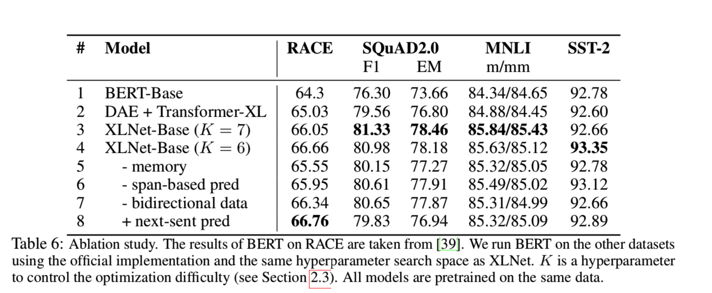
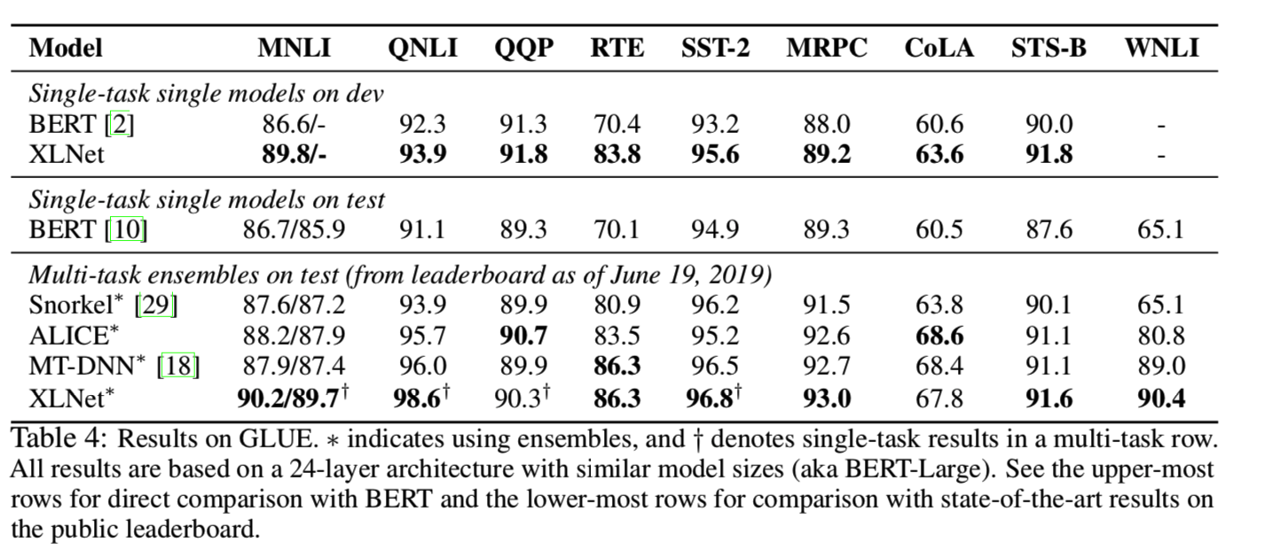
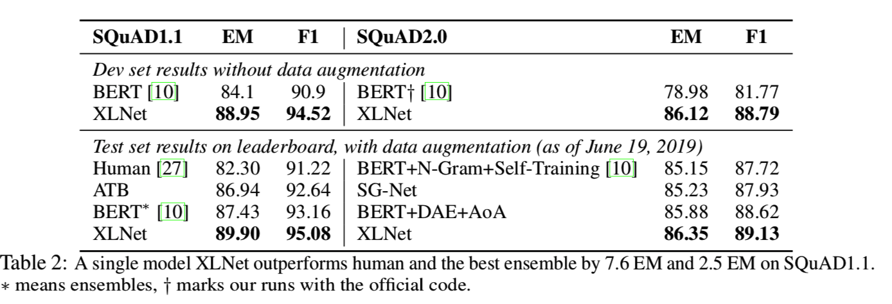
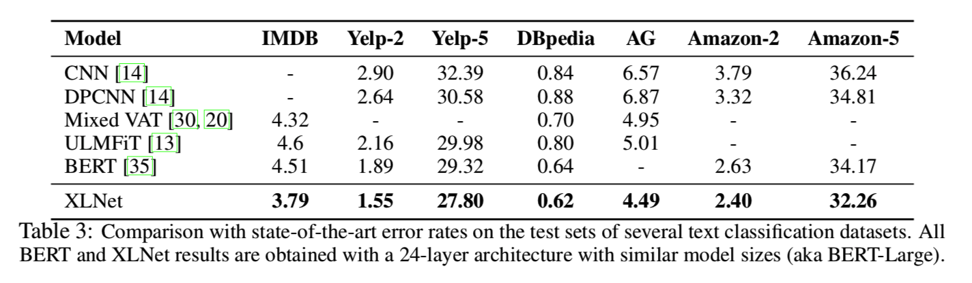
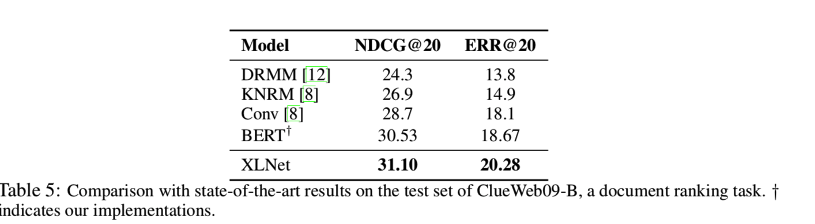
XL-NET
result

Slide 25
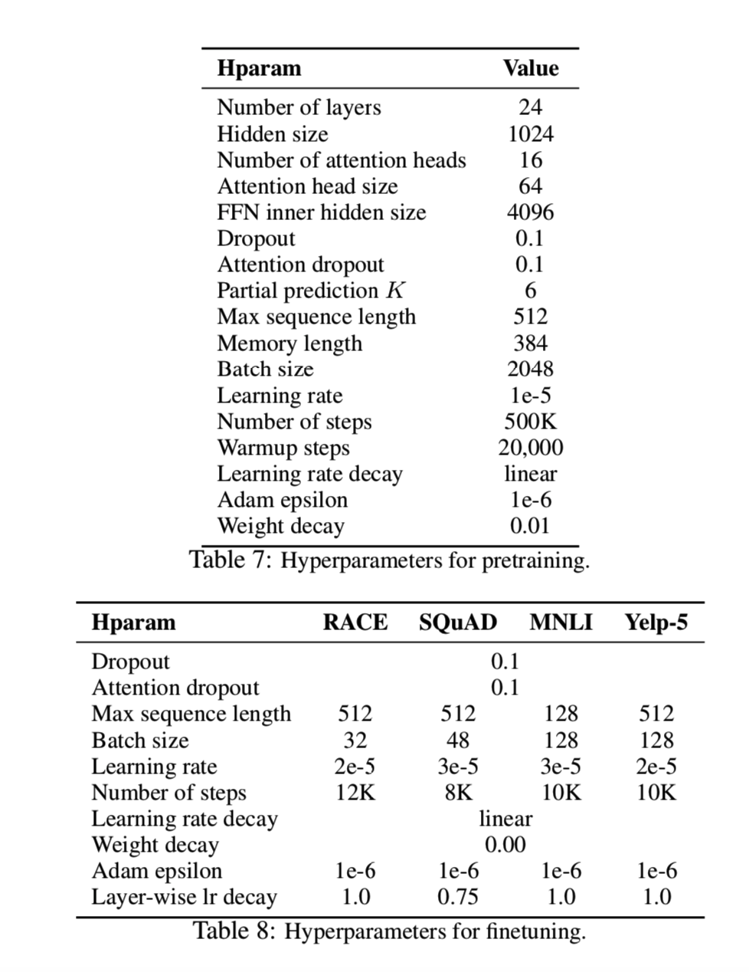
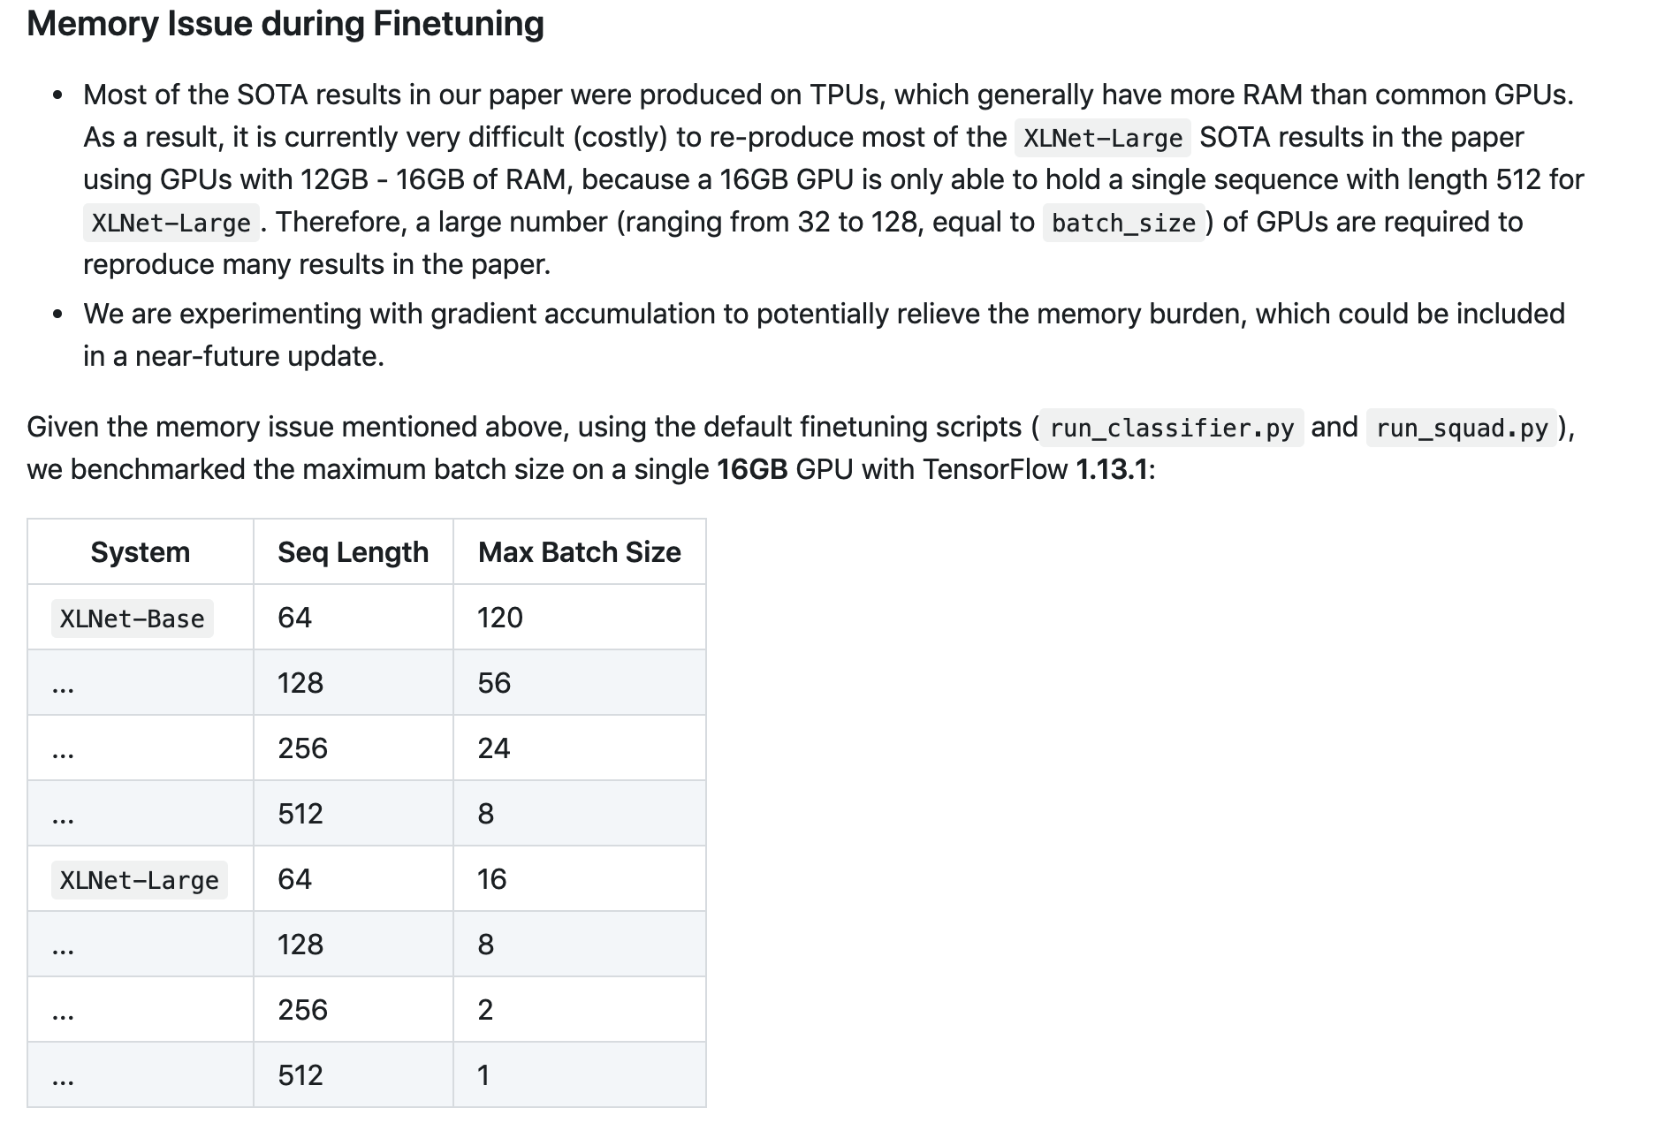
训练参数
XL-NET

Slide 26
XL-NET
优点：
1、 Permutation Language Model，捕捉上下文
2、相对位置编码、分段RNN机制，适用长文档任务
3、超越bert，高性能
缺点：
1、运行速度慢，参数大，吃硬件，配置要求高
2、目前没有中文预训练模型
https://arxiv.org/pdf/1906.08237.pdf
https://github.com/zihangdai/xlnet
https://mp.weixin.qq.com/s/o35E4rFkm4KsL_2a3fqe_Q

